Slide 1
Design Patterns - Introduction
Continuous staff improvement project
Yurii Hohan

Slide 2
Introduction
Design patterNs. The idea behind them.
Pattern scope.
Classification.
Factory pattern.
Singleton (different implementation of Singleton in C#).

Slide 3
pattern
A pattern is a recurring solution to a standard problem, in a context.
Christopher Alexander, a professor of architecture…
Why would what a prof of architecture says be relevant to software?
“A pattern describes a problem which occurs over and over again in our environment, and then describes the core of the solution to that problem, in such a way that you can use this solution a million times over, without ever doing it the same way twice.”

Slide 4
What is Pattern?
Jim Coplein, a software engineer: “I like to relate this definition to dress patterns…”
What are dress patterns?
“... I could tell you how to make a dress by specifying the route of a scissors through a piece of cloth in terms of angles and lengths of cut. Or, I could give you a pattern. Reading the specification, you would have no idea what was being built or if you had built the right thing when you were finished. The pattern foreshadows the product: it is the rule for making the thing, but it is also, in many respects, the thing itself.”

Slide 5
Patterns in engineering
How do other engineers find and use patterns?
Mature engineering disciplines have handbooks describing successful solutions to known problems
Automobile designers don't design cars from scratch using the laws of physics
Instead, they reuse standard designs with successful track records, learning from experience
“Be sure that you make everything according to the pattern I have shown you here on the mountain.” Exodus 25:40.
Developing software from scratch is also expensive
Patterns support reuse of software architecture and design

Slide 6
Motivation
OOD methods emphasize design notations
Fine for specification, documentation
But OOD is more than just drawing diagrams
Good draftsmen  good designers
Good OO designers rely on lots of experience
At least as important as syntax
Most powerful reuse is design reuse
Match problem to design experience

Slide 7
Recurring Design Structures
OO systems exhibit recurring structures that promote
abstraction
flexibility
Modularity
Therein lies valuable design knowledge
Problem: capturing, communicating, & applying this knowledge

Slide 8
Four Basic Parts
Pattern name: increases vocabulary of designers
Problem: intent, context, when to apply
Solution: UML-like structure, abstract code
Consequences: results and tradeoffs
Language & implementation-independent
A “micro-architecture”

Slide 9
Goals
Codify good design
distill & generalize experience
aid to novices & experts alike
Give design structures explicit names
common vocabulary
reduced complexity
greater expressiveness
Capture & preserve design information
articulate design decisions succinctly
improve documentation

Slide 10
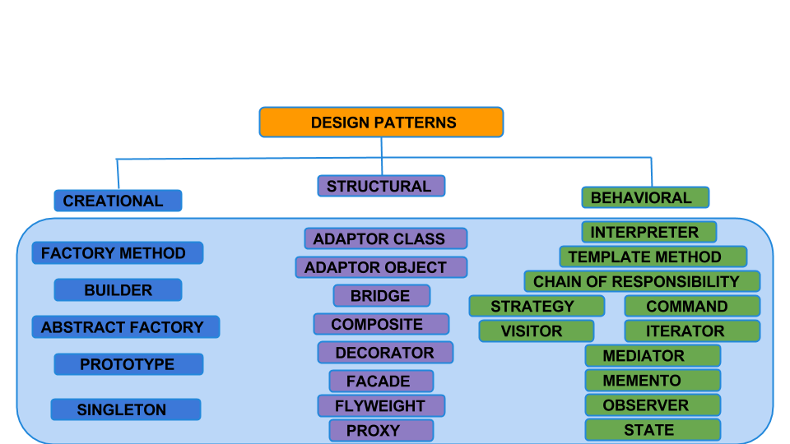
Design Patterns Classification

Slide 11
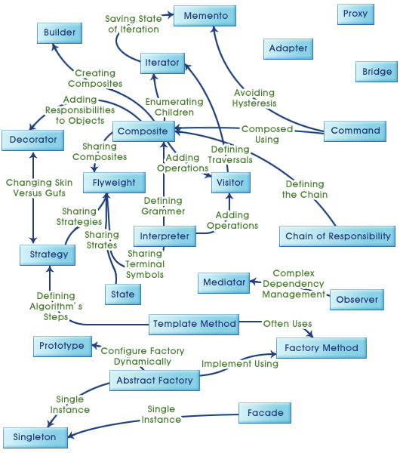
Design Patterns Relationships

Slide 12
Creational Patterns
Creational design patterns abstract the instantiation process.
There are two recurring themes in these patterns.
First, they all encapsulate knowledge about which concrete classes the system uses.
Second, they hide how instances of these classes are created and put together.

Slide 13
Singleton
Intent
Ensure a class only has one instance, and provide a global point of access to it.
Motivation
It’s important for some classes to have exactly one instance. Although there can be many printers in a system, there should be only one printer spooler. There should be only one file system and one window manager.

Slide 14
Singleton
Applicability
Use the Singleton pattern when
• there must be exactly one instance of a class, and it must be accessible to clients from a well-known access point.
• when the sole instance should be extensible by subclassing, and clients should be able to use an extended instance without modifying their code.

Slide 15
Singleton vs Static class
 | Singleton | Static class
Point of access | One and exactly one – static field Instance | N(the visibility scope of static class)
Inheritance | Possible | Not possible
Can be passed as a parameter | Possible | Not possible
Control of life cycle | Possible | Not possible
Serialization | Possible | Not possible
Using params during first instantiation | Possible | Not possible

Slide 16
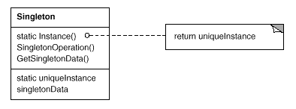
Singleton. structure

Slide 17
Singleton. Participants and collaborations.
Participants.
– Singleton defines an Instance operation that lets clients access its unique instance. Instance is static.
– may be responsible for creating its own unique instance.
Collaborations
Clients access a Singleton instance solely through Singleton’s Instance operation.
Related Patterns
Many patterns can be implemented using the Singleton pattern. See Abstract Factory (87), Builder (97), and Prototype (117).

Slide 18
Singleton. Consequences.
1. Controlled access to sole instance. Because the Singleton class encapsulates its sole instance, it can have strict control over how and when clients access it.
2. Reduced name space. The Singleton pattern is an improvement over global variables. It avoids polluting the name space with global variables that store sole instances.
3. Permits refinement of operations and representation. The Singleton class may be subclassed, and it’s easy to configure an application with an instance of this extended class. You can configure the application with an instance of the class you need at run-time.
4. Permits a variable number of instances. The pattern makes it easy to change your mind and allow more than one instance of the Singleton class. Moreover, you can use the same approach to control the number of instances that the application uses. Only the operation that grants access to the Singleton instance needs to change.

Slide 19
First Attempt
public sealed class Singleton
{
private static Singleton instance=null;
private Singleton()
{
}
public static Singleton Instance
{
get
{
if (instance==null)
{
instance = new Singleton();
}
return instance;
}
}
}

Slide 20
First Attempt - Disadvantages
Not thread-safe. Two different threads could both have evaluated the test if (instance==null) and found it to be true, then both create instances, which violates the singleton pattern.
Rule of thumb. Static classes and methods need to be considered for multithreading.

Slide 21
Second Attempt
public sealed class Singleton
{
private static Singleton instance = null;
private static readonly object padlock = new object();
private Singleton()
{
}
public static Singleton Instance
{
get
{
lock (padlock)
{
if (instance == null)
{
instance = new Singleton();
}
return instance;
}
}
}
}

Slide 22
Second Attempt - Disadvantages
Note that instead of locking on typeof(Singleton) as some versions of this implementation do, this implementation’s lock is on the value of a static variable which is private to the class.
Locking has larger granularity than it should. We should lock only the process of creation of the singleton.

Slide 23
Third Attempt
public sealed class Singleton
{
private static Singleton instance = null;
private static readonly object padlock =
new object();
private Singleton()
{
}
public static Singleton Instance
{
get
{
if (instance == null)
{
lock (padlock)
{
if (instance == null)
{
instance = new Singleton();
}
}
}
return instance;
}
}
}

Slide 24
Third Attempt - Disadvantages
We cannot ensure that the constructor completes before the reference to the new object is assigned to instance. To do it, we should use volatile, and go deep into knowledge of memory barriers.
It's easy to get wrong and generally the code looks complicated.

Slide 25
Fourth Attempt
public sealed class Singleton
{
private static readonly Singleton instance = new Singleton();
// Explicit static constructor to tell C# compiler to initialize field only on first of class.
static Singleton()
{
}
private Singleton()
{
}
public static Singleton Instance
{
get
{
return instance;
}
}
}

Slide 26
FiFTH Attempt
public sealed class Singleton
{
private Singleton()
{
}
public static Singleton Instance { get { return Nested.instance; } }
private class Nested
{
static Nested()
{
}
internal static readonly Singleton instance = new Singleton();
}
}

Slide 27
Sixth Attempt
public sealed class Singleton
{
private static readonly Lazy<Singleton> lazy = new Lazy<Singleton>(() => new Singleton(), true);
public static Singleton Instance { get { return lazy.Value; } }
private Singleton()
{
}
}

Slide 28
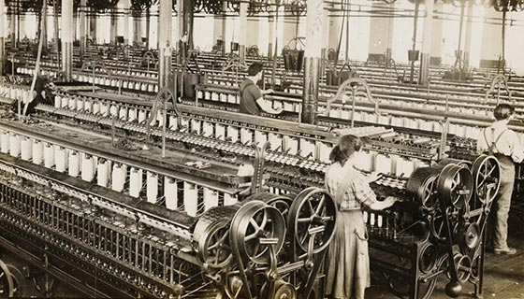
Factory
A commonly recognised term in object-orientated programming is Factory. A Factory is an object that has the sole responsibility to create other objects. when something has the responsibility for creating another object, it’s called a Factory.

Slide 29
Factory
Intent. Factories are often used to create Aggregates. As we looked at in last week’s tutorial on Aggregates, Aggregates provide encapsulation and a consistent boundary around a group of objects.
Standardises the instantiation of an object
Factories provide encapsulation
Objects should not be responsible for their own creation
The Factory Design Pattern is probably the most used design pattern in modern programming languages like Java and C#. It comes in different variants and implementations. If you are searching for it, most likely, you'll find references about the GoF patterns: Factory Method and Abstract Factory.
We'll describe a flavor of factory pattern commonly used nowdays. You can also check the original Factory Method pattern which is very similar.

Slide 30
Factory
Motivation.
Separate responsibility for creating the object from it.
Make factory responsible of creating always valid object graphs.
Document different scenarios of using instances in method names.
Avoid code duplication.

Slide 31
Factory
Applicability.
Multistate object creation. Object will always be created in a single place in a valid state.
Aggregate object creation. The created aggregate is always valid.
Best place to apply rules on object creation. E.g. – adding object to the database.

Slide 32
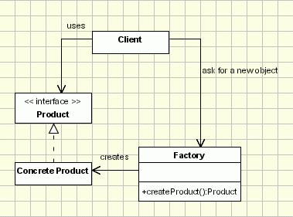
Factory. structure

Slide 33
Factory. Participants and collaborations.
Participants.
– Factory defines all the rules of creation of Products inside it. One could create subtypes of both Products and Factory.
Collaborations
Clients create Products by calling Factory methods.
Related Patterns
Different variations of the pattern: Abstract Factory, Factory Method

Slide 34
No Factory.
public class Product
{
public string Name { get; set; }
public string Description { get; set; }
public long Price { get; set; }
public long Ranking { get; set; }
public IList<long> CategoryIds { get; set }
}
What are the problems?

Slide 35
No Factory. Better Aproach
public class Product
{
public string Name { get; private set; }
public string Description { get; private set; }
public long Price { get; private set; }
public long Ranking { get; private set; }
public IList<long> CategoryIds { get; private set; }
public Product(string name, string description, long price, long ranking, IList<long> categoryIds)
{
if (string.IsNullOrWhiteSpace(name))
throw new ArgumentException("name is required.");
if (price <= 0)
throw new ArgumentException("price must be positive.");
if (!categoryIds.Any())
throw new ArgumentException("Assign product to at least one category.");
Name = name;
Description = description;
Price = price;
Ranking = ranking;
CategoryIds = categoryIds;
}
}

Slide 36
No Factory. Better Aproach
public class Product
{
public string Name { get; private set; }
public string Description { get; private set; }
public long Price { get; private set; }
public long Ranking { get; private set; }
public IList<long> CategoryIds { get; private set; }
public Product(string name, string description, long price, long ranking, IList<long> categoryIds)
{
if (string.IsNullOrWhiteSpace(name))
throw new ArgumentException("name is required.");
if (price <= 0)
throw new ArgumentException("price must be positive.");
if (!categoryIds.Any())
throw new ArgumentException("Assign product to at least one category.");
Name = name;
Description = description;
Price = price;
Ranking = ranking;
CategoryIds = categoryIds;
}
}

Slide 37
Simple Factory.
public interface IProductOptions
{
IProductOptions WithDescrption(Func<string> desciptionDelegate);
string GetDescription();
}
public class ProductFactory
{
public static Product CreateNewProduct(string name, long price, IList<long> categoryIds,
Action<IProductOptions> optionalParams)
{
var options = new ProductOptions();
if (optionalParams != null)
optionalParams(options);
string description = options.GetDescription();
if (string.IsNullOrWhiteSpace(description))
description = "No Description available";
var product = new Product(name, description, price, 0, categoryIds);
OnProductCreation(product);
return product;
}

Slide 38
Simple Factory.
public static Product CreateExportedProduct(string name, long price, long ranking, IList<long> categoryIds,
Action<IProductOptions> optionalParams)
{
var options = new ProductOptions();
if (optionalParams != null)
optionalParams(options);
string description = options.GetDescription();
if (string.IsNullOrWhiteSpace(description))
description = "No Description available";
var product = new Product(name, description, price, ranking, categoryIds);
OnProductCreation(product);
return product;
}
public static void OnProductCreation(Product product)
{
//send newsletter
}

Slide 39
Simple Factory.
public static Product CreateExportedProduct(string name, long price, long ranking, IList<long> categoryIds,
Action<IProductOptions> optionalParams)
{
var options = new ProductOptions();
if (optionalParams != null)
optionalParams(options);
string description = options.GetDescription();
if (string.IsNullOrWhiteSpace(description))
description = "No Description available";
var product = new Product(name, description, price, ranking, categoryIds);
OnProductCreation(product);
return product;
}
public static void OnProductCreation(Product product)
{
//send newsletter
}

Slide 40
Simple Factory.
public class ProductOptions : IProductOptions
{
private string _description;
public IProductOptions WithDescrption(Func<string> desciptionDelegate)
{
_description = desciptionDelegate();
return this;
}
public string GetDescription()
{
return _description;
}
}
}
public class Client
{
public IList<Product> GetNewProducts(int number)
{
for (long i = 0; i < number; i++)
{
var product = ProductFactory.CreateNewProduct(string.Format("Product {0}", i), i, i,
opt => opt.WithDescrption(() => "Description"));
}
}
}

Slide 41
Assignment
Implement Singleton in your project.
Implement factory in your project.

